Slide 1
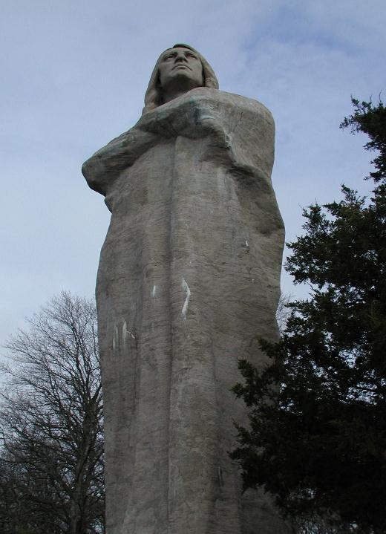
Lorado Taft Field Campus Outdoor Education Program

Slide 2
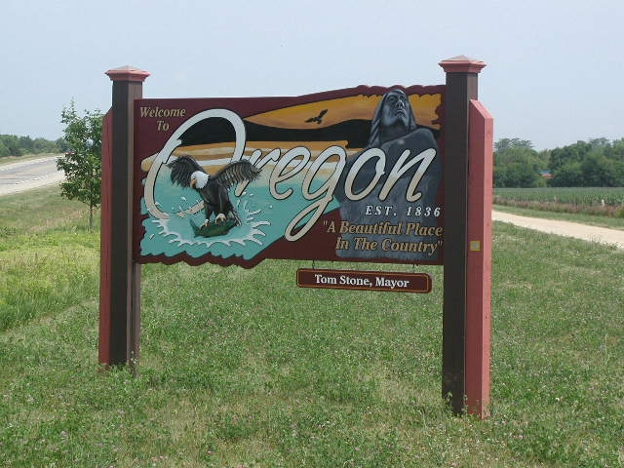
Notes:
Lorado Taft Field Campus is located just north of Oregon, Illinois.

Slide 3
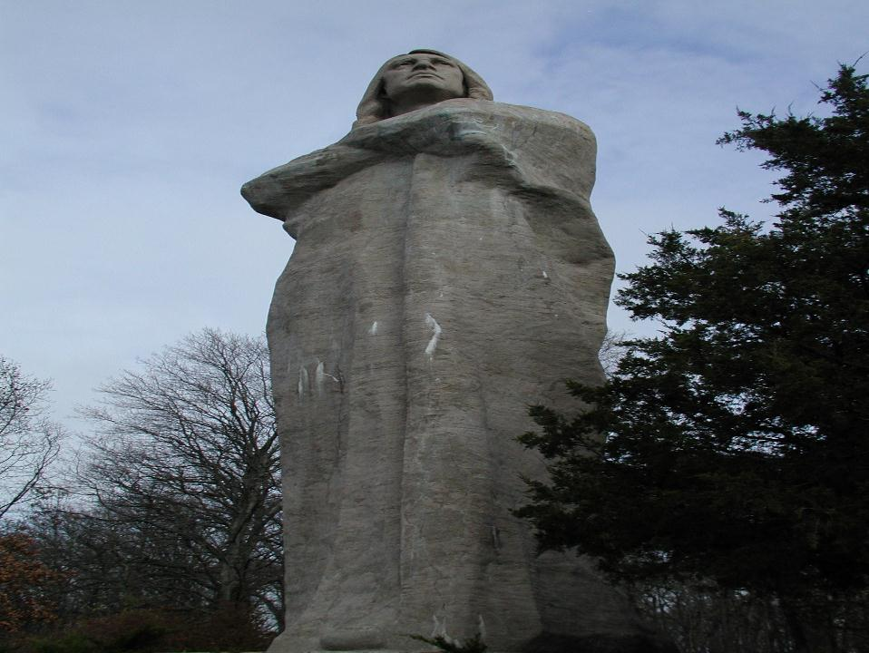
What Is Lorado Taft Campus?
Division of Northern Illinois University Outreach
Residential Outdoor Education Center
7000+ elementary and middle school students a year
Conference Center
conferences, corporate groups, youth groups
Notes:
Lorado Taft Field Campus is owned and operated by Northern Illinois University in the division of Outreach. Our mission is to educate school age children about the natural world around them.

Slide 4
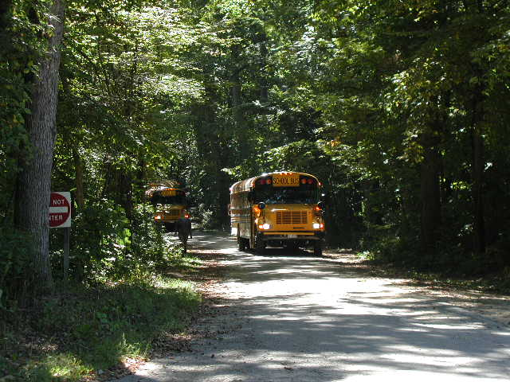
Arrival
Notes:
Busses arrive at Taft Campus

Slide 5
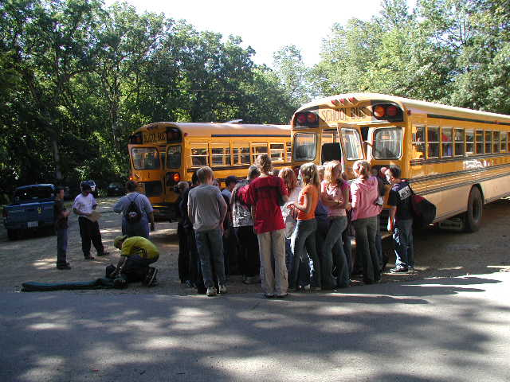
Notes:
The first task upon arrival is to get everyone’s luggage off the bus and into the dorm.

Slide 6
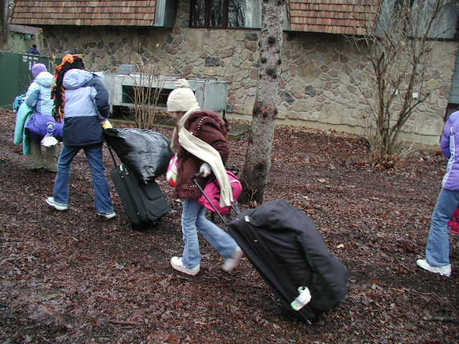
Notes:
Students take luggage to the dorms and settle in for a few minutes.

Slide 7
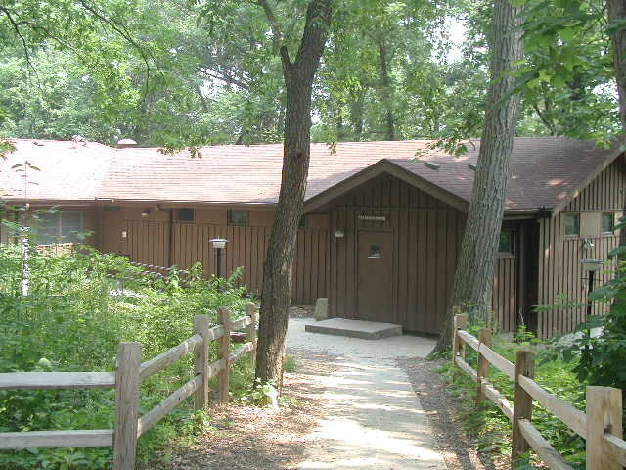
Clarkson Dorm
Notes:
Clarkson Dorm

Slide 8
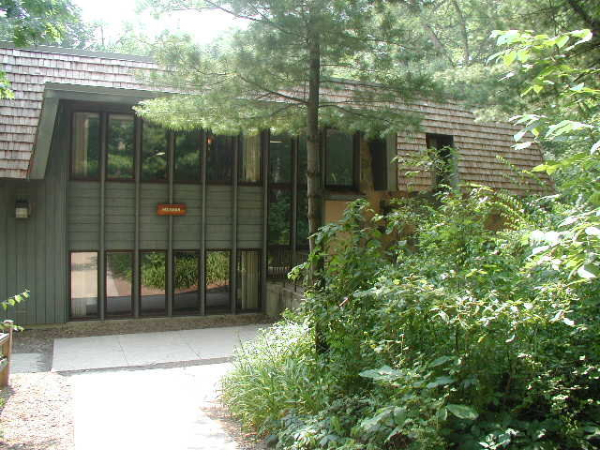
Heckman Dorm
Notes:
Heckman Dorm

Slide 9
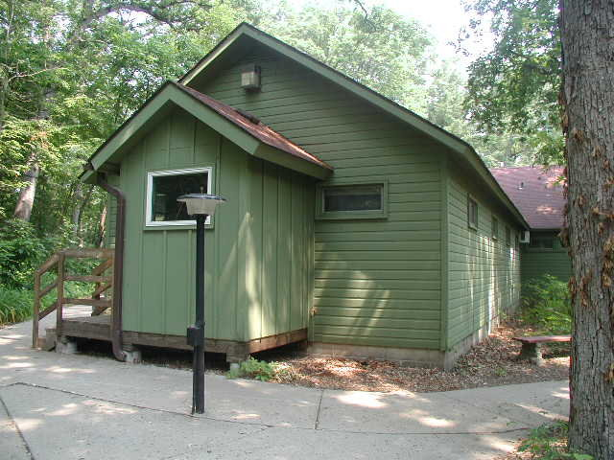
Grover Dorm
Notes:
Grover Dorm

Slide 10
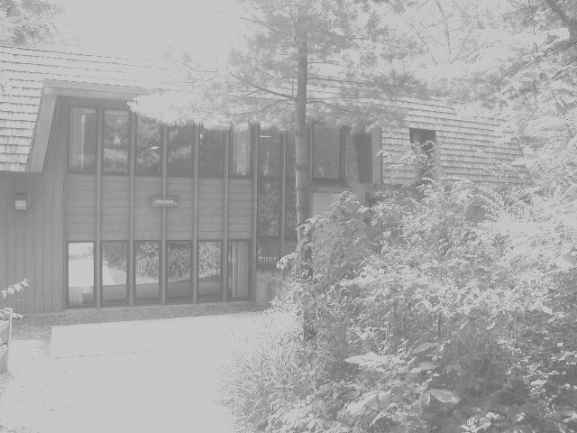
All Dorms Include:
Pillows and Mattress Covers
Indoor Plumbing
Hot, Private Showers
Heat and Air Conditioning
Dressers
Separate Teacher/Chaperone Bedrooms
Notes:
Add text box with info about dorms

Slide 11
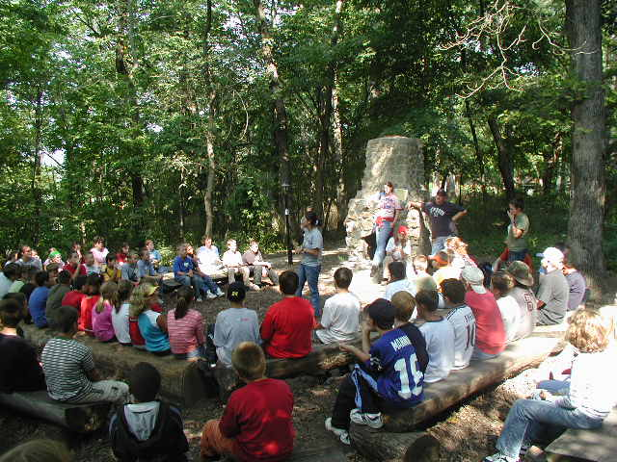
Orientation
Meet the staff
Taft rules
Campus tour
Notes:
After settling into the dorm, students meet in a central location for an orientation.

Slide 12
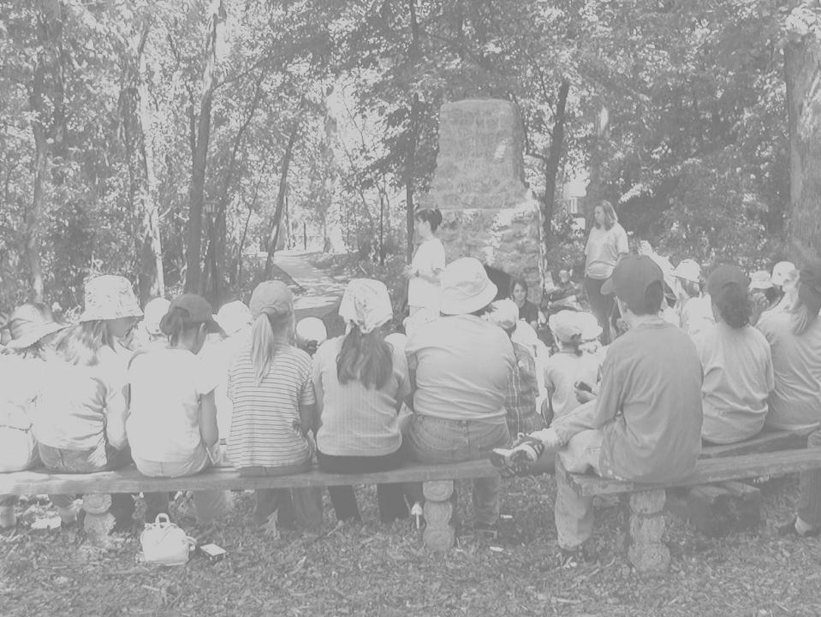
Taft Guidelines
Be On Time
Please Walk
Stay With an Adult
Dress for the Weather
Respect: Environment, Self and Others
Notes:
Guidelines at Taft

Slide 13
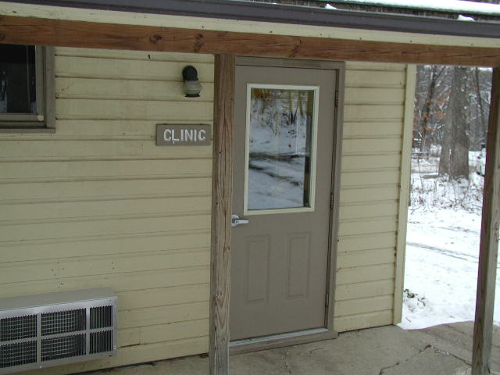
Nurse’s Office & Clinic
Notes:
After Orientation, students are given a tour so they can locate class locations, the main office, the dining hall, and clinic.
Clinic. The Nurse is on duty from 7:30am-3:00pm each day there are students on campus.

Slide 14
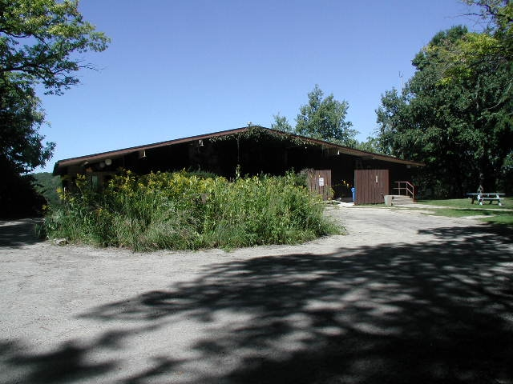
Dining Hall
Notes:
Dining Hall

Slide 15
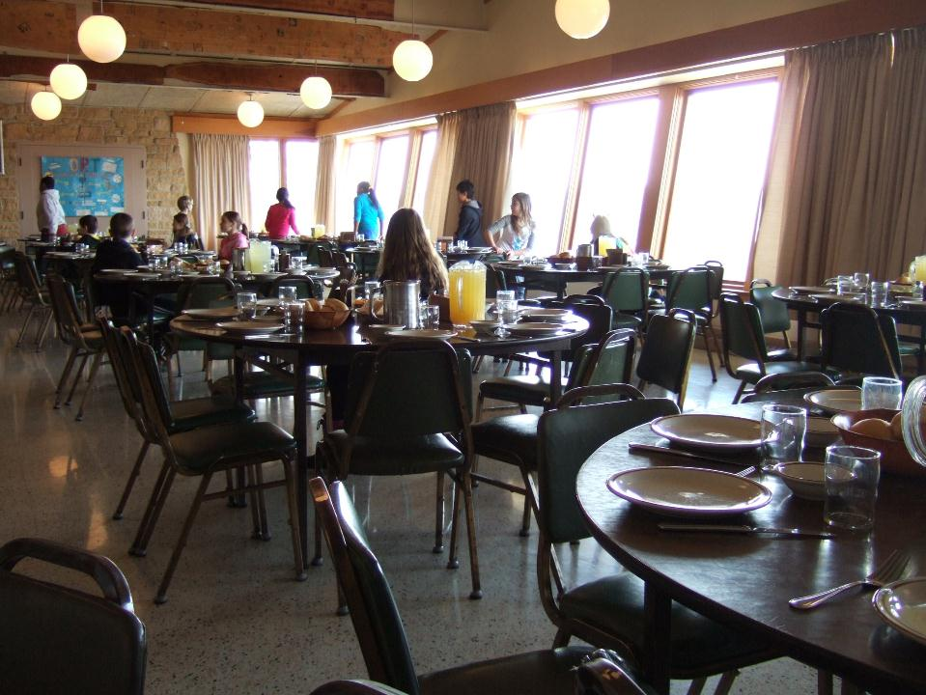
Hoppers setting tables
Notes:
Hoppers setting the tables in the dining hall a half hour before the meal.

Slide 16
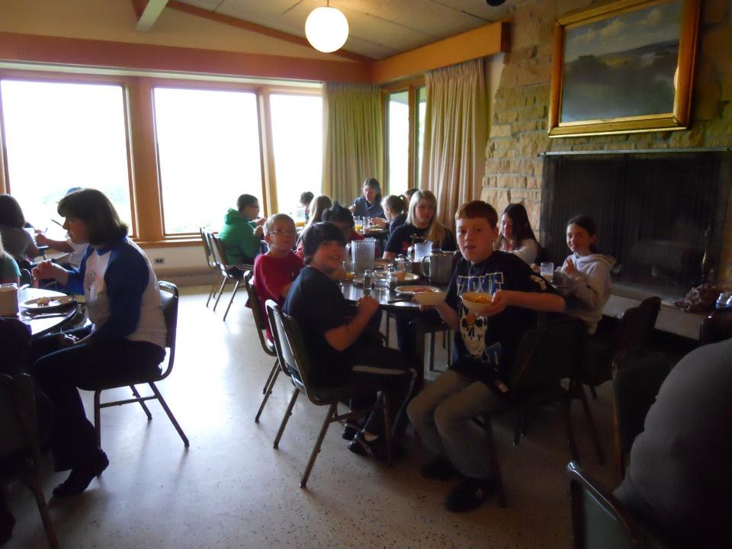
Notes:
Students enjoying a meal at Lorado Taft Campus.

Slide 17
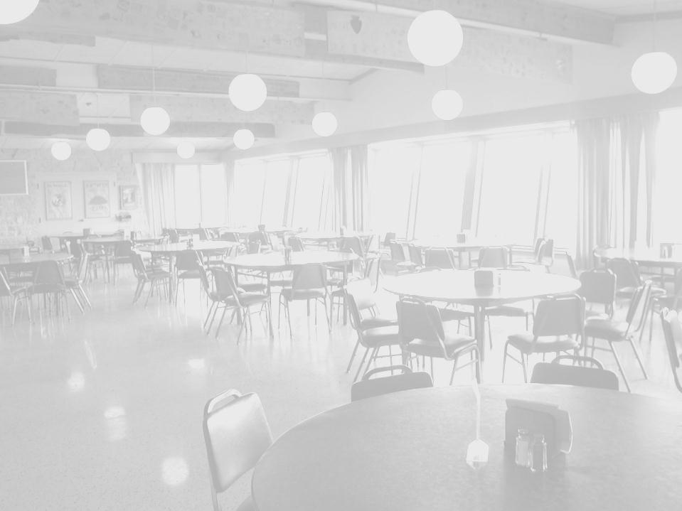
Dining Hall
Meals are served family style
Home cooked meals
All you can eat
Students are hoppers (set up, serve, clean up)
Peanut and tree nut free
Most dietary needs can be accommodated with notification
Notes:
Dining hall details

Slide 18
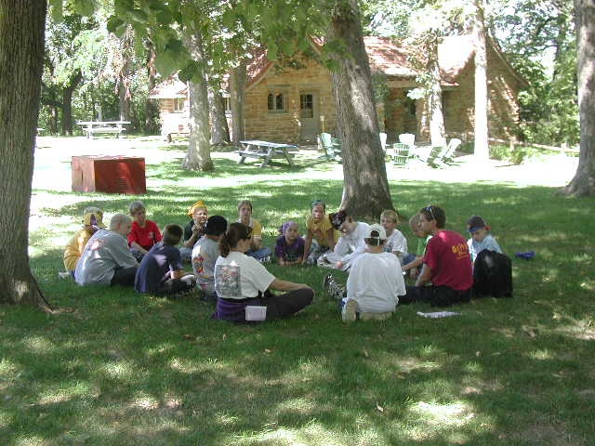
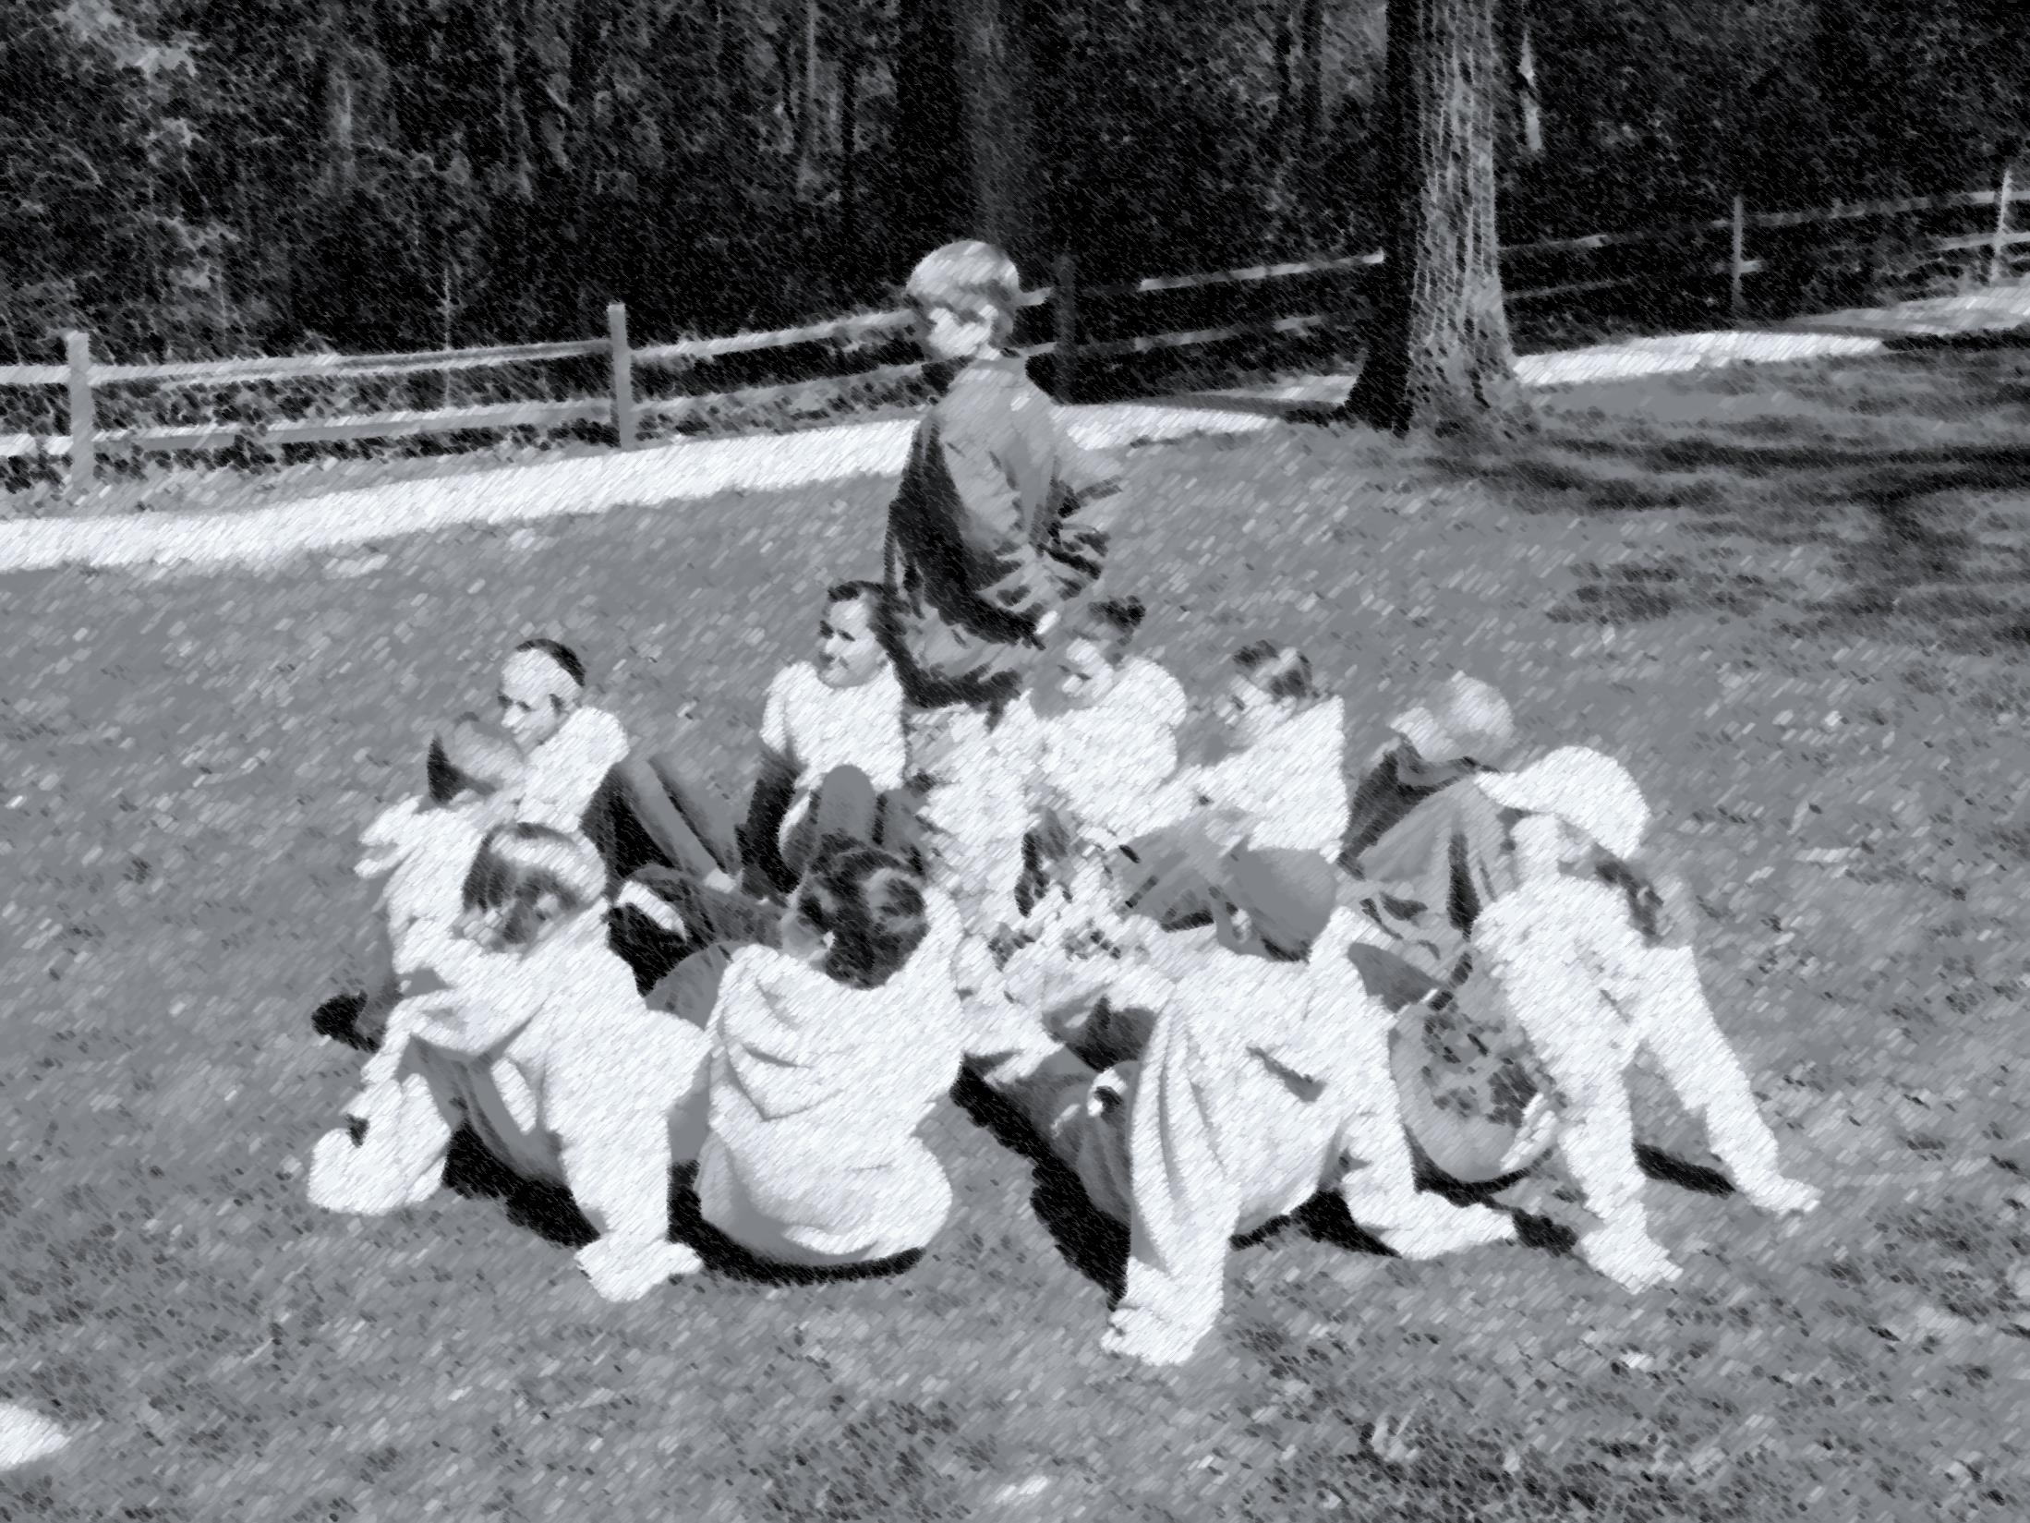
ACTIVITIES
Notes:
These student are using the outdoors as a classroom site while they discuss nature.

Slide 19
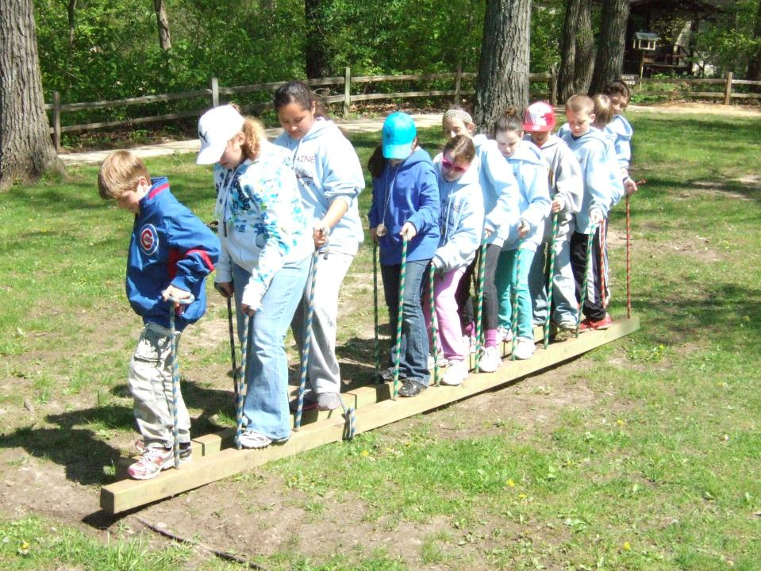
TEAM BUILDING
Notes:
Team Building. These students are working together to move the whole team toward a goal without anyone falling off the trolleys. This activity takes good communication and group coordination.

Slide 20
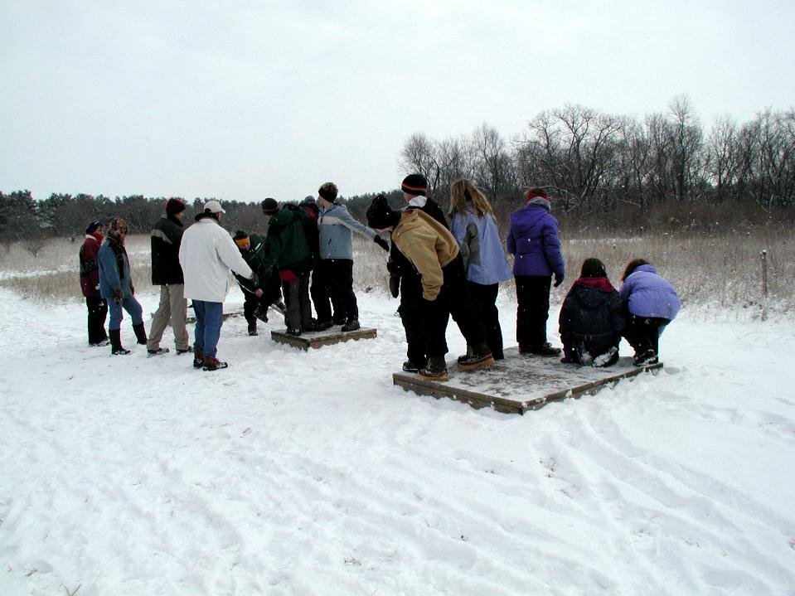
TEAM BUILDING
Notes:
Team Building. Students are trying to get their entire group on top of the small platform.

Slide 21
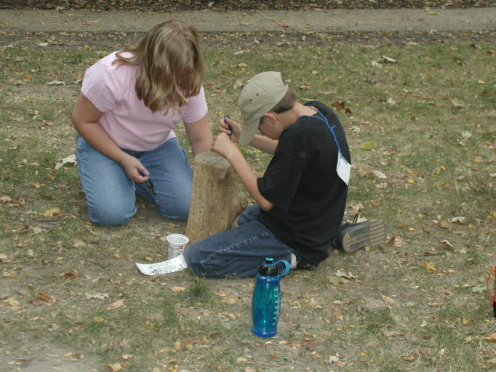
BIRDING
Notes:
Birds. Students learn how bird beaks are adapted to what they eat, by trying to acquire different “food sources” with their “beaks.”

Slide 22
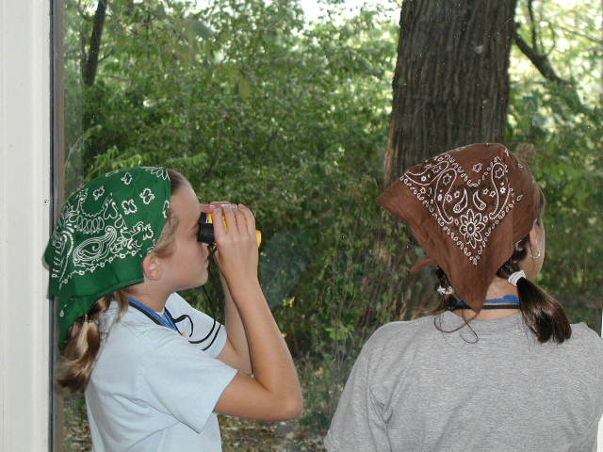
BIRDING
Notes:
Birds. Students watch birds on the bird porch.

Slide 23
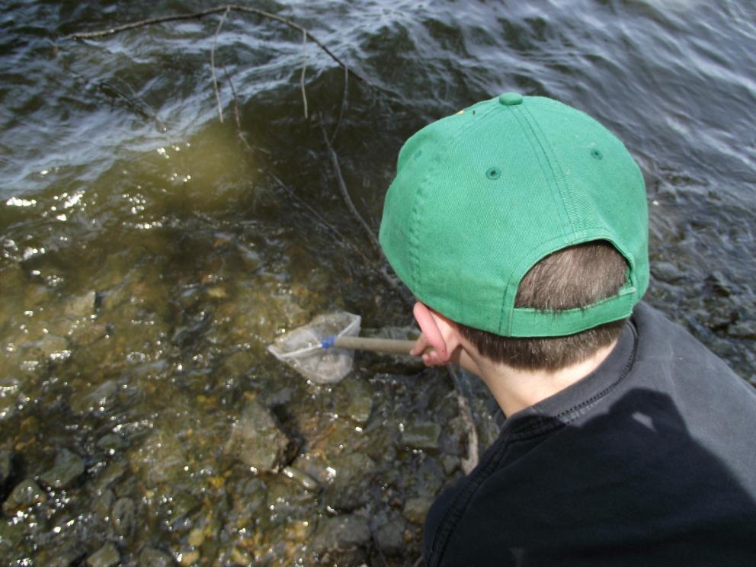
WATER ECOLOGY
Notes:
Water Study. This is the Rock River. Students will use nets and pick up rocks to look for organisms that live in the river. The types of organisms help to determine the health of the river.

Slide 24
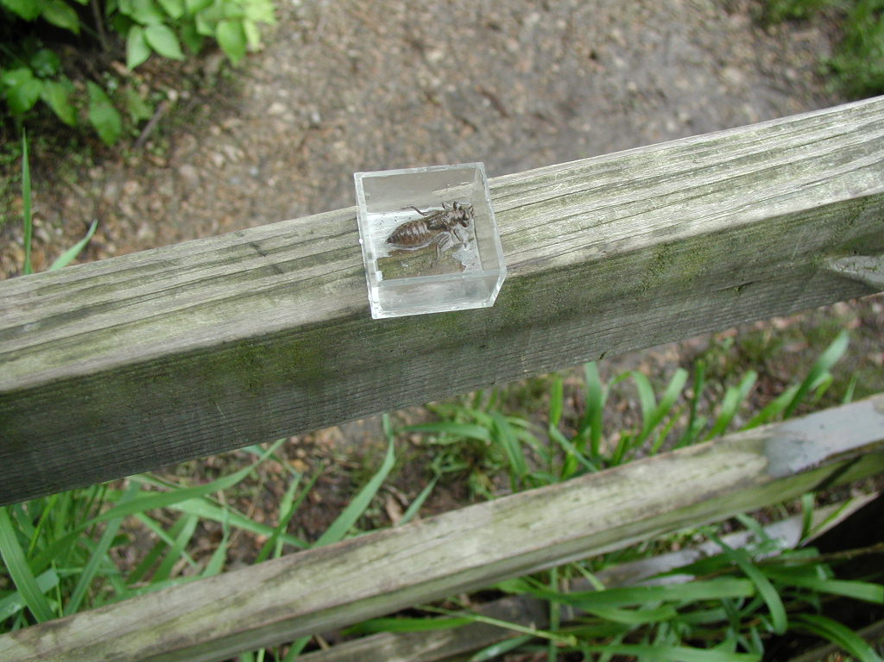
WATER ECOLOGY
Notes:
Water Ecology. This is a dragonfly nymph found in the water along the edge of the river. This is a good example of the types of indicator species that the student are looking for.

Slide 25
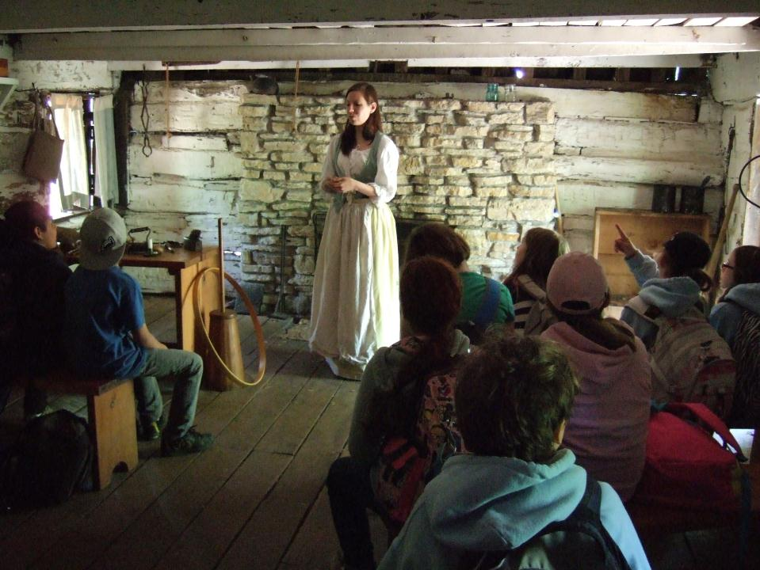
PIONEERING
Notes:
Pioneering. Our staff dress in period clothing to interpret life in the early to mid 19th century. This is the interior of our 165 year old cabin.

Slide 26
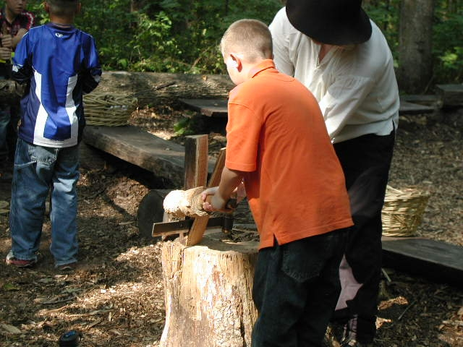
PIONEERING
Notes:
Pioneering. This student is using a froe and maul to spilt pieces of wood. This tool was used to make shingles for houses, pegs for construction, or kindling for fire.

Slide 27
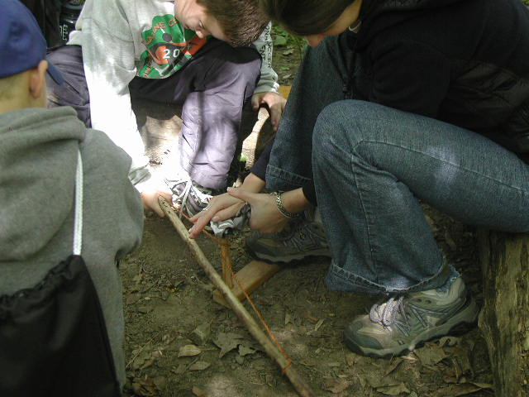
NATIVE AMERICANS
Notes:
Native Americans. A group of students working together to try to start a fire using a bowdrill.

Slide 28
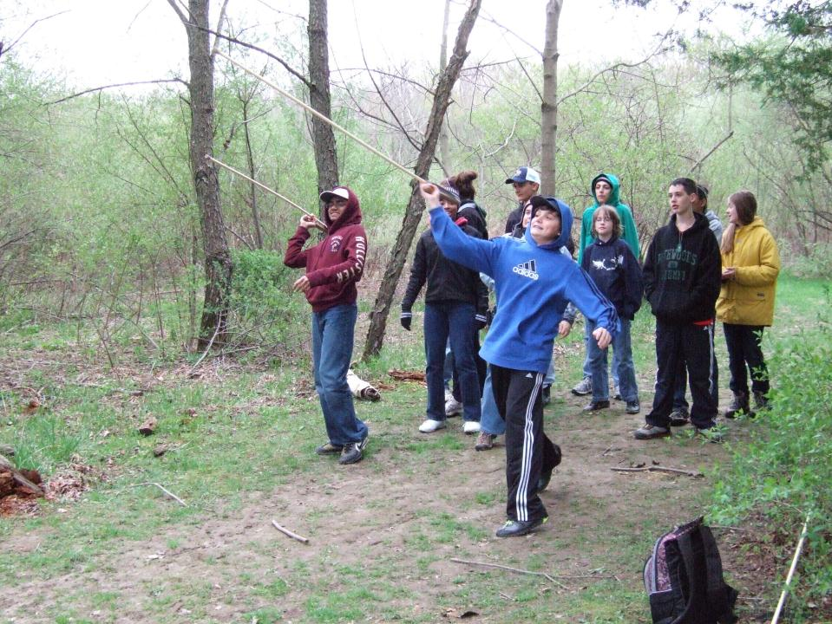
NATIVE AMERICANS
Notes:
Native Americans. Students learning to use atl atl.

Slide 29
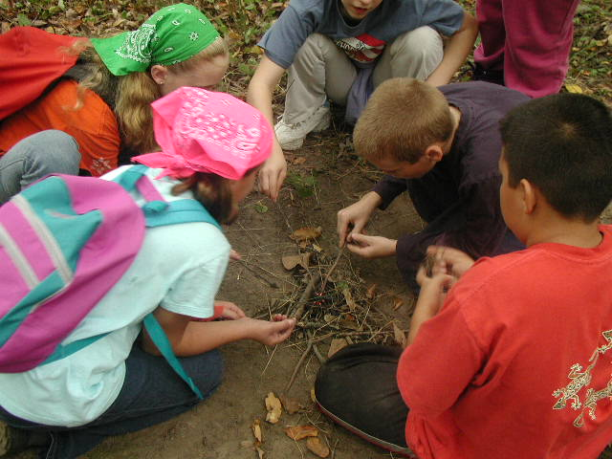
SURVIVAL
Notes:
Survival. Students work together to build a fire with only one match.

Slide 30
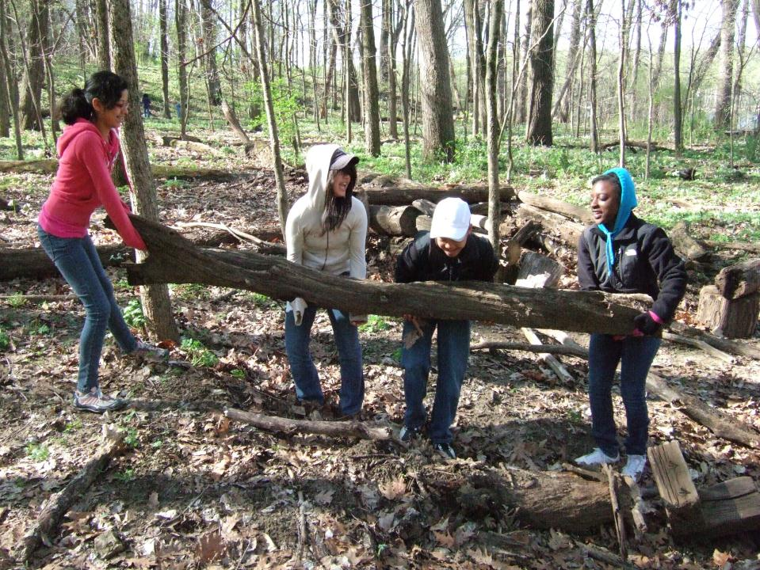
SURVIVAL
Notes:
Survival. Students working to construct a survival shelter.

Slide 31
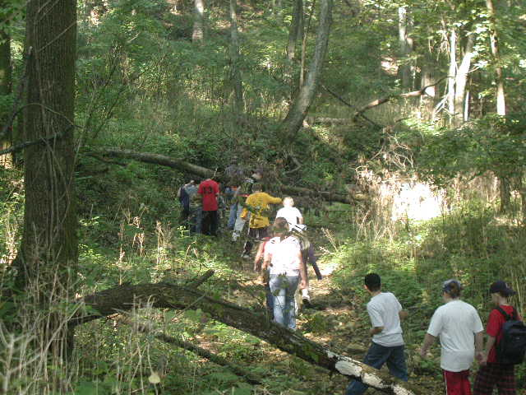
GEOLOGY
Notes:
Geology. While exploring the gully that runs through Taft Campus, students can learn about topics such as rock formation and identification, erosion, stream formation, and the geologic history of northern Illinois.

Slide 32
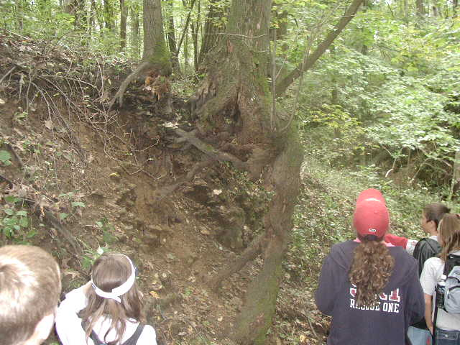
GEOLOGY
Notes:
Geology. Students examine a tree’s exposed roots - the result of erosion in the gully.

Slide 33
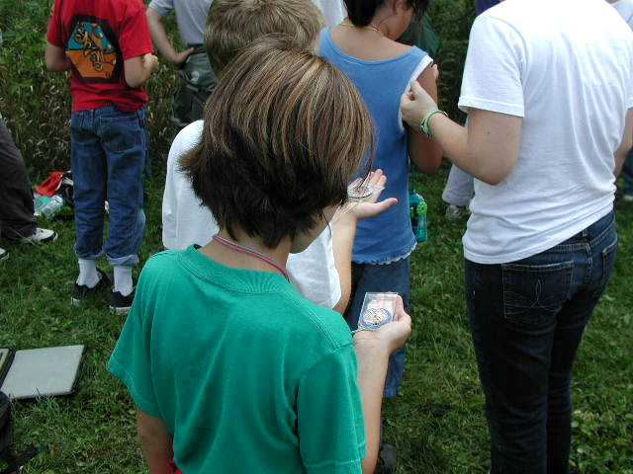
ORIENTEERING
Notes:
Orienteering. A group of students at a post on the orienteering course reading the bearing to find the direction to the next post.

Slide 34
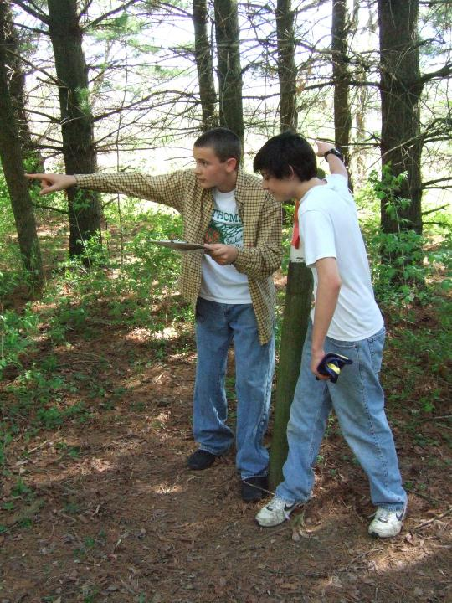
ORIENTEERING
Notes:
Orienteering. A student points the direction to the next post.

Slide 35
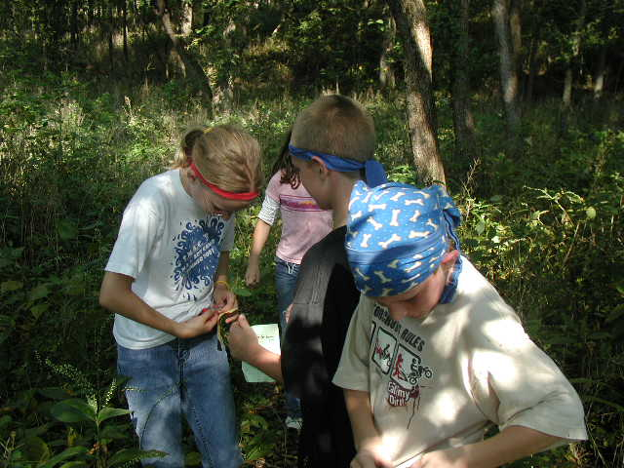
INSTINCTS FOR SURVIVAL
Notes:
Instincts for Survival is a predator-prey game played in a large field. These students are in a chip exchange. That means that one animal has “eaten” another. The prey animal gives a chip to the predator.

Slide 36
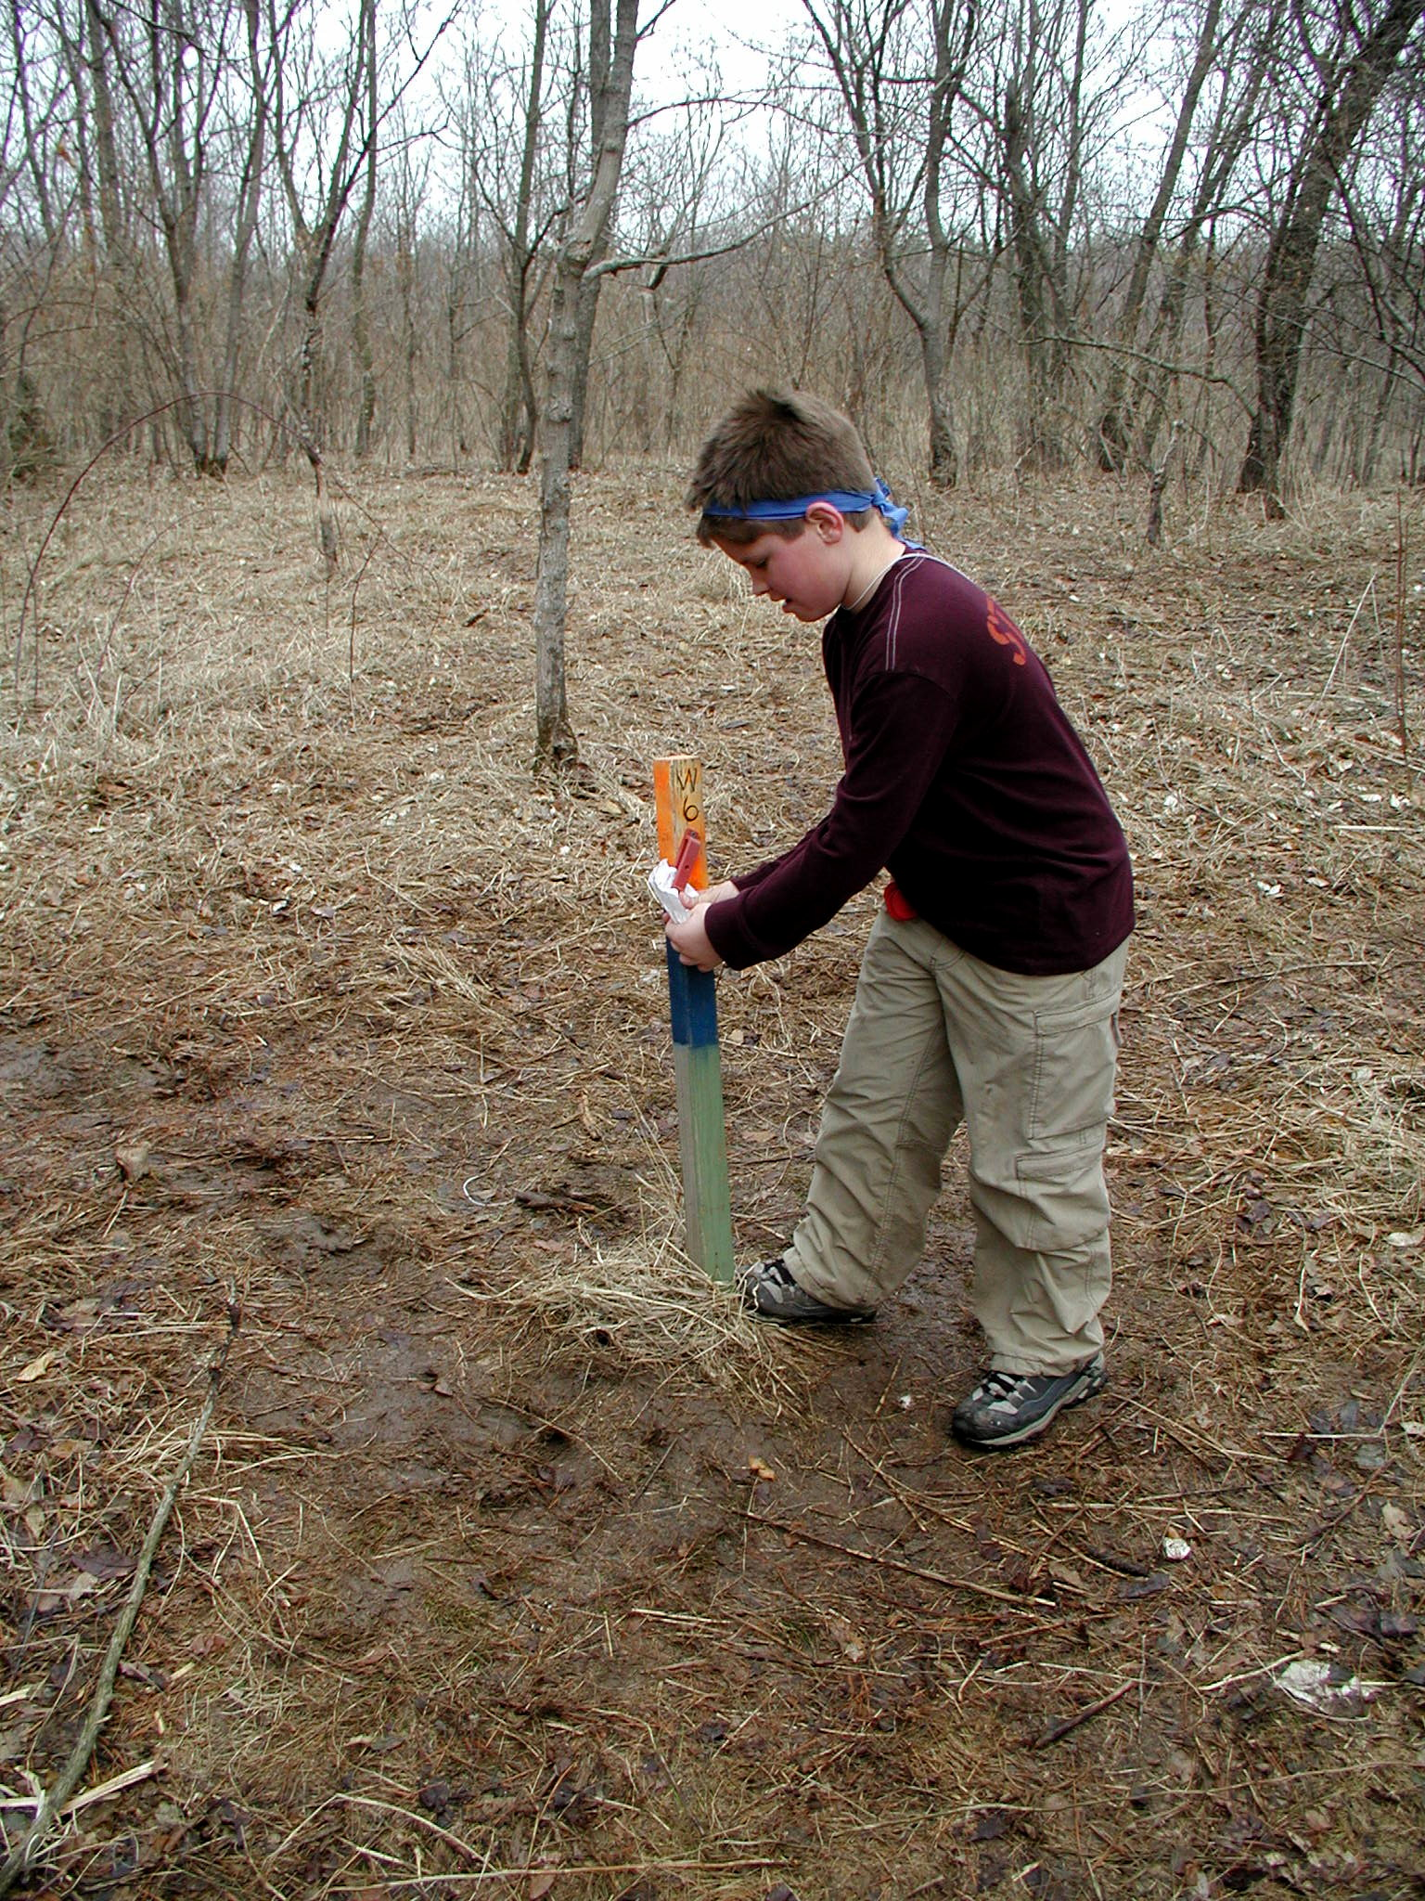
INSTINCTS FOR SURVIVAL
Notes:
Instincts for Survival. This student in punching his food and water sheet to acquire one of the elements needed for survival.

Slide 37
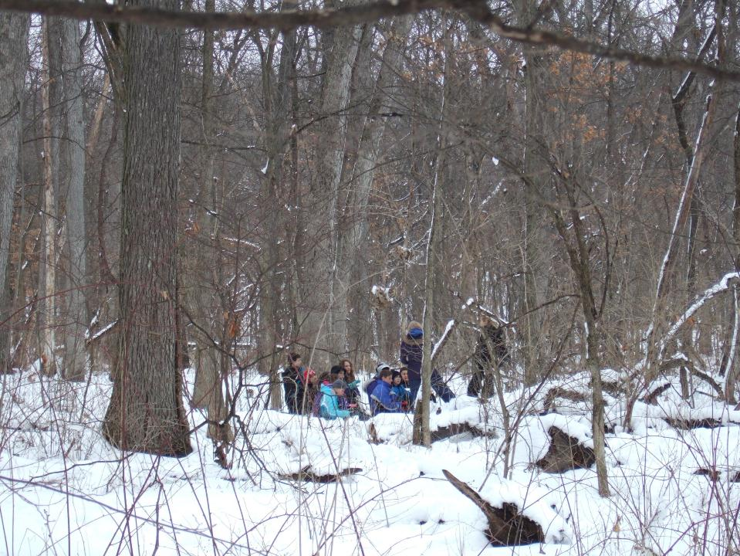
WINTER ECOLOGY
Notes:
In the cold and snow, we adapt our ecology classes to a winter focus. Examples of activities might include tracking or activities focused on how animals survive the winter.

Slide 38
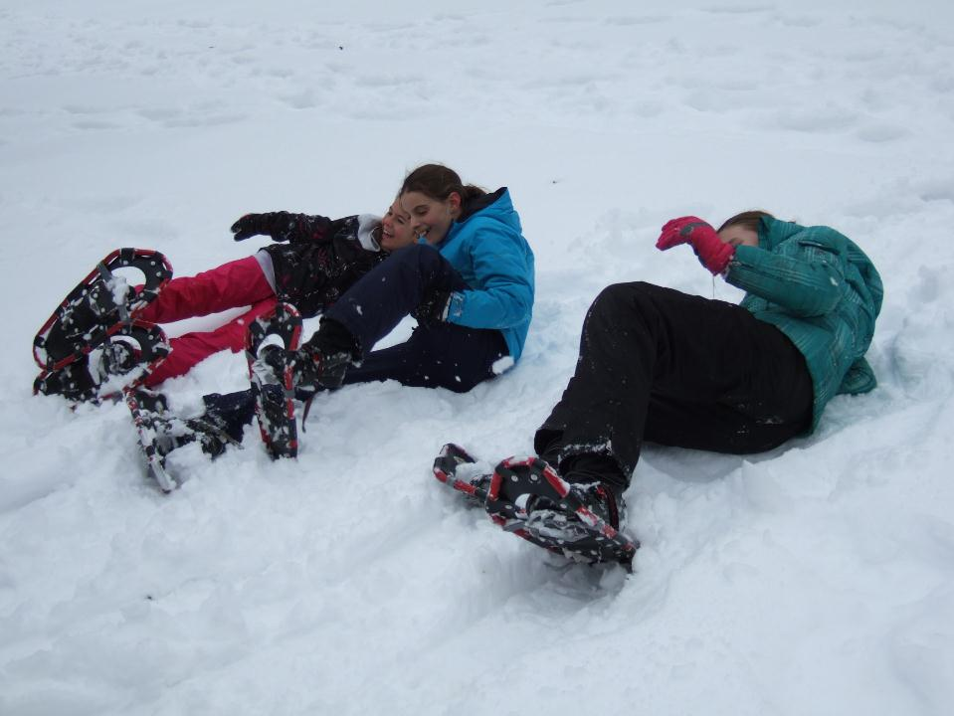
Snowshoeing
Notes:
Students might also get the opportunity to try out snowshoeing or cross country skiing.

Slide 39
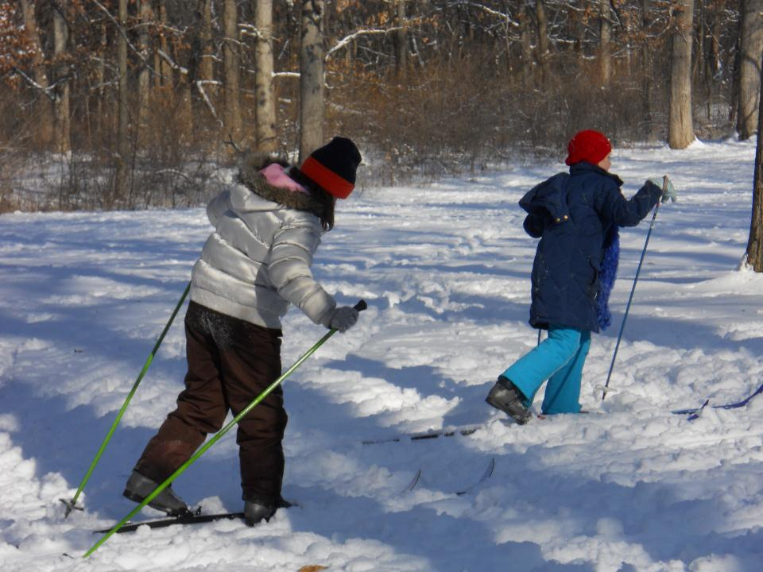
Cross-Country Skiing

Slide 40
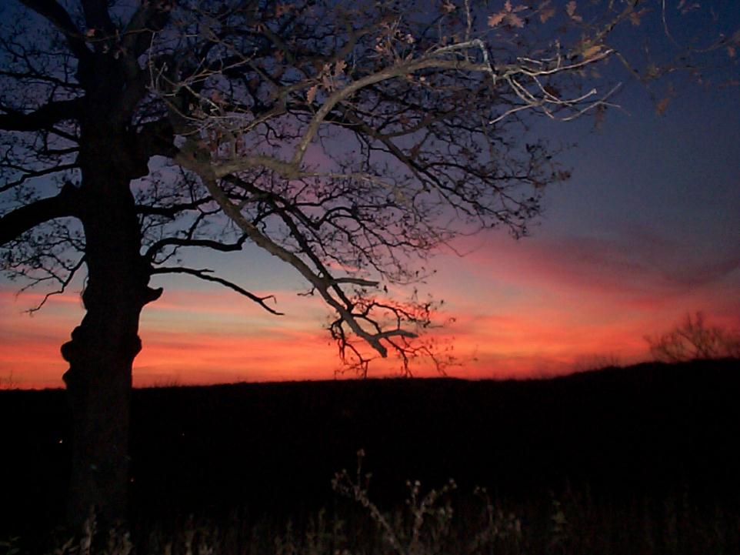
EVENING PROGRAMS
Notes:
The sun setting over the river. The day at Taft is still not over. After dinner the students will get to experience the evening programs.

Slide 41
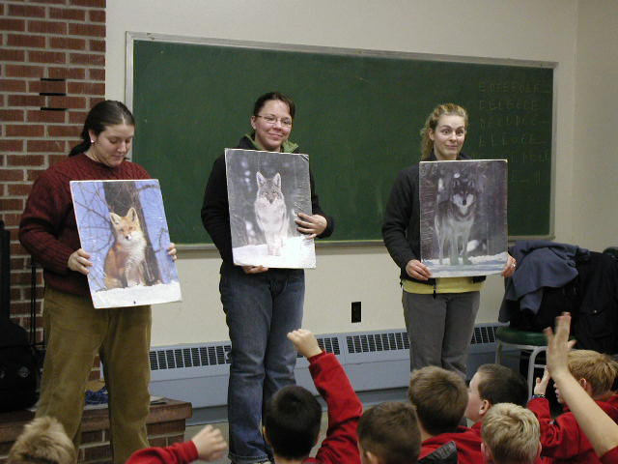
ALPHA WOLF
Notes:
Alpha Wolf. Students are learning some introductory information about wolves prior to playing Alpha Wolf. Alpha Wolf is a large group activity that simulates the communication of a wolf pack.

Slide 42
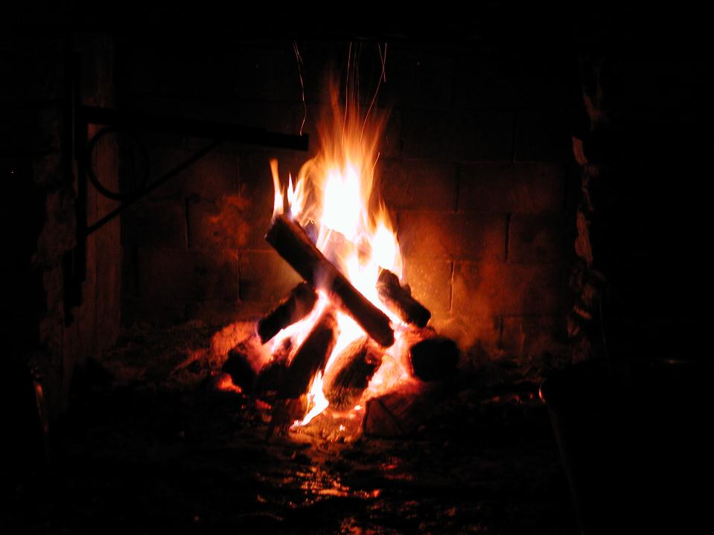
CAMPFIRE
Notes:
Most groups enjoy a campfire program while at Lorado Taft.

Slide 43
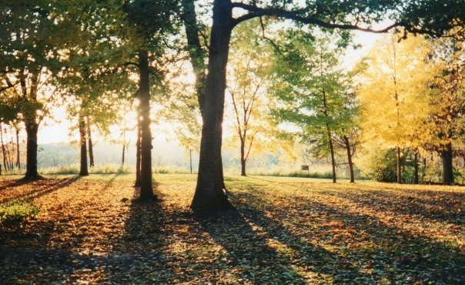
FLORA & FAUNA AT TAFT
Notes:
No matter what the season, there are beautiful things to experience at Taft – the colors of autumn, the eagles soaring over the river in the winter, or the spring wildflowers.

Slide 44
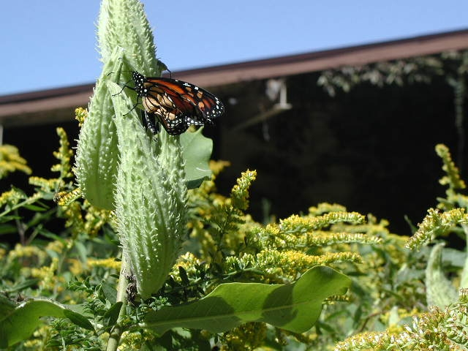
Notes:
One of the best things about Taft is the animals and plants that you get to see. Monarch on Milkweed

Slide 45
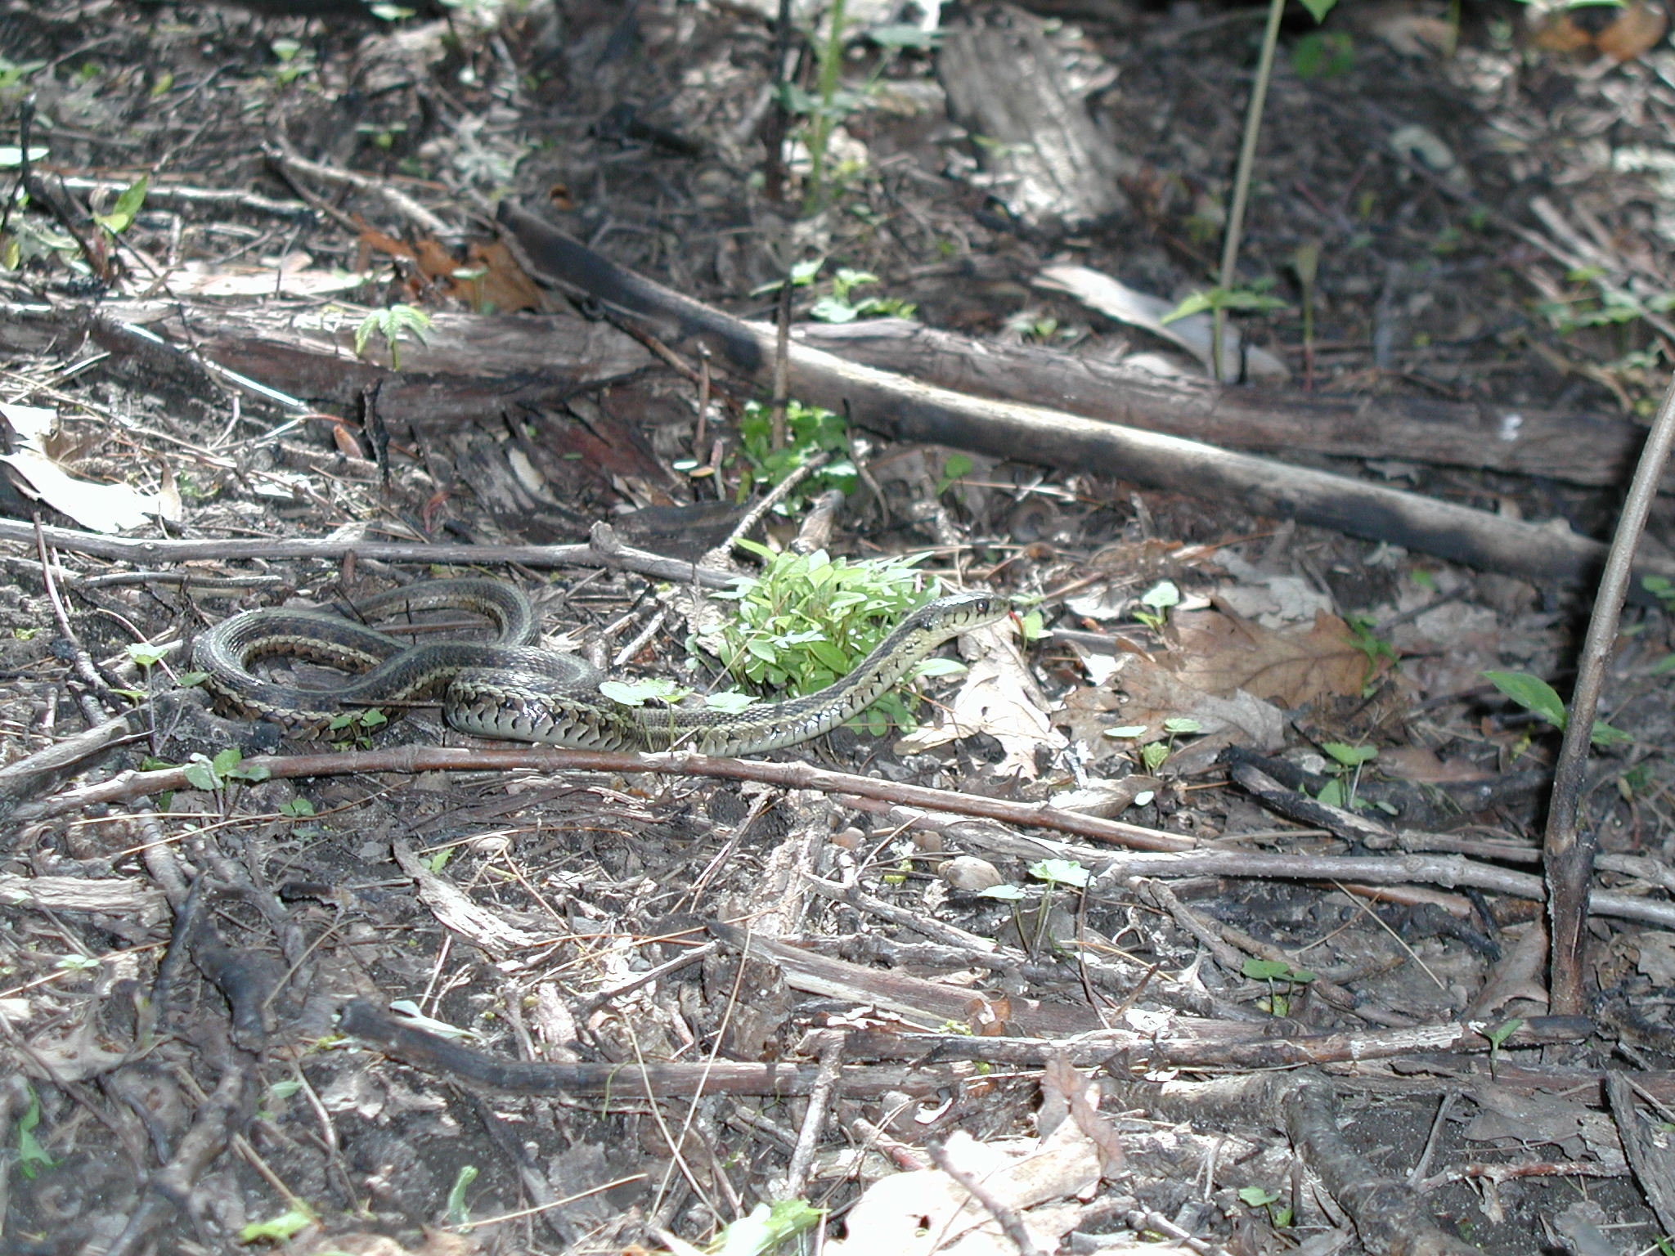
Notes:
Garter Snake

Slide 46
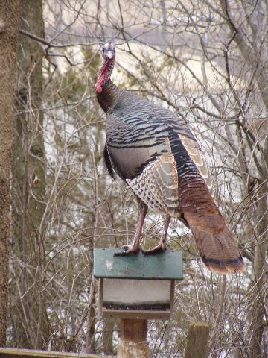
Notes:
Turkey perched on a birdfeeder.

Slide 47
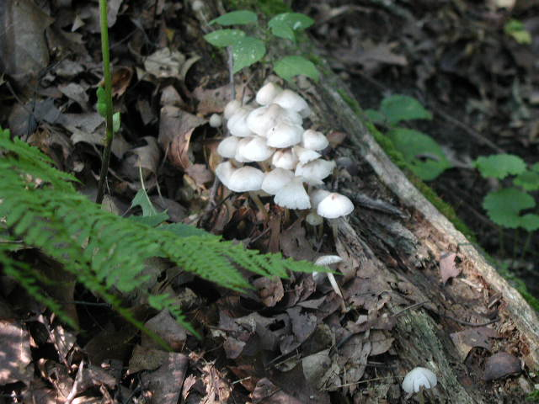
Notes:
Fungus on a decaying log.

Slide 48
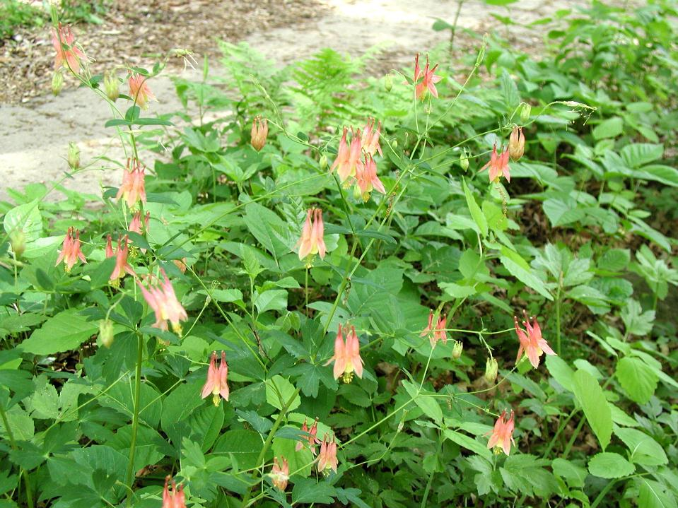
Notes:
Columbine flowers

Slide 49
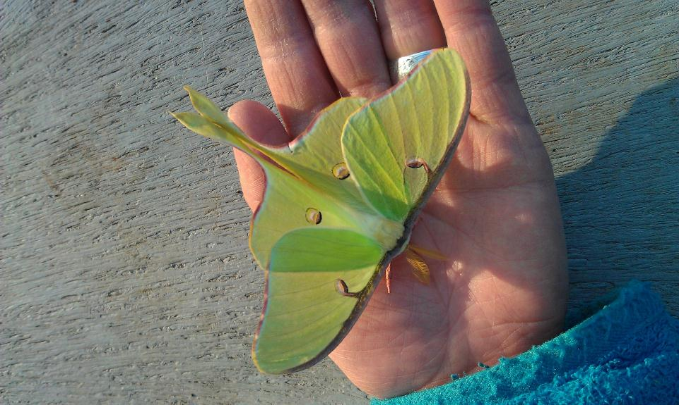
Notes:
A luna moth

Slide 50
Notes:
Racoon at a bird feeder

Slide 52
Notes:
After all of the excitement, fun, food, and learning, it is time to head home. Students and teachers load luggage back onto their buses.

Slide 53
WAVING GOODBYE
Notes:
Staff wave goodbye as the busses depart.

Slide 54
For more information:
www.niu.edu/taft
815-732-2111

