Slide 1
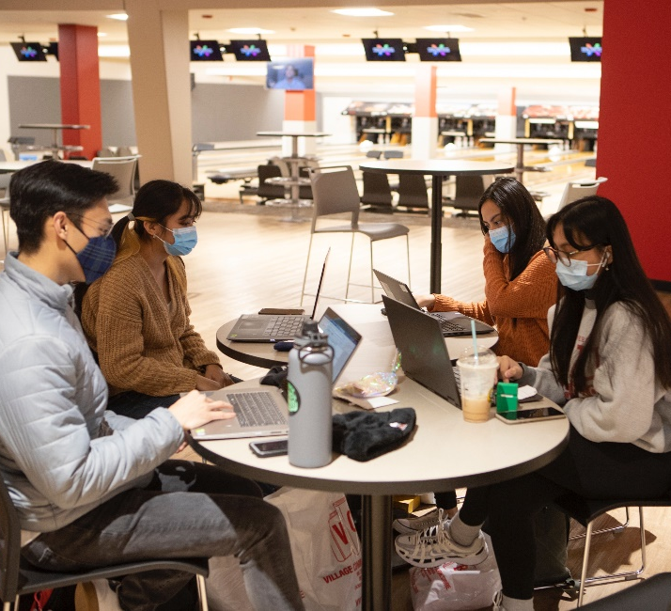
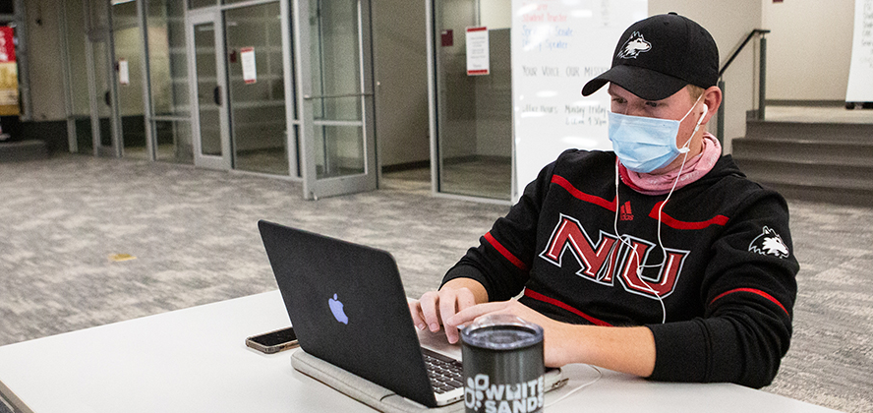
Learning Management System (LMS) Review Overview and Progress Update
May 13, 2021
niu.edu/lms-review
© 2017 Northern Illinois University
Notes:
[Jason] Good morning! Thank you for the opportunity to share briefly today about NIU’s Learning Management System Review project, provide an update on our progress to date, and answer any questions that you might have. I’ll begin with some brief background and overview and then turn it over to Matt Parks to briefly discuss our review process, timeline, and next steps.
NIU is in the final year of a three-year contract with Blackboard, our current Learning Management System (LMS) vendor. While faculty usage and overall satisfaction with Blackboard remains high, the university hasn’t conducted a formal evaluation of other LMS systems in a number of years.
The university is conducting a LMS review during the 2020-2021 academic year. This evaluation is broad in scope with input from faculty, staff and students on not only their current satisfaction with NIU's current LMS but also what features are desired in a LMS moving forward. Through NIU’s partnership with Internet2, the top three leading LMS platforms in Higher Education – Blackboard Learn, D2L Brightspace, and Instructure Canvas – are being reviewed to ensure that we select a platform that will serve the core interests of the university for years to come. The evaluation will supply the data to prepare a recommendation on whether an alternative LMS should be considered at this time. A website has been developed for the project with complete details.

Slide 2
Overview and History of Blackboard at NIU
emergency remote instruction
Blackboard Learn
Community System
Content System
Collaborate and Mobile Learn
research on usage
migration to cloud
Blackboard
Ultra
1999
2003
2007
2011
2016+
2018
2019
2020
Notes:
Blackboard Learn was originally licensed at NIU in 1999 to facilitate the delivery of web-based courses, but it has since been used much more broadly as a critical system for facilitating teaching and learning.
Over time, other components have been added (initially individually priced but now included in our license):
Blackboard Community System in 2003 - facilitates non-academic use of Blackboard
Blackboard Content System in 2007 - file repository for storage and sharing, within and outside of courses
Blackboard Collaborate in 2011 - two-way audio/video web conferencing
Blackboard Mobile Learn in 2011 – mobile app for student and faculty access to Blackboard on smartphones and tablets
NIU hosted Blackboard locally from 1999 to 2018, when it was migrated to the cloud to reduce costs, increase performance, and provide a path to the Ultra Experience, Blackboard’s modern and completely redesigned interface. The Ultra Base Navigation and Course View were introduced in Spring 2019.
Blackboard was relied upon heavily in the pivot to emergency remote instruction in response to the pandemic and continues to be a mission critical technical platform for NIU.

Slide 3
Usage of Blackboard at NIU
98.3% students
94.7% instructional staff
68.2% course sections
Notes:
As I mentioned, Blackboard Learn is used widely today at NIU. As of our last pre-pandemic term in fall 2019, Blackboard was used by 98% of students and 95% of faculty and instructors, for 68% of all course sections, averaging 4.5 courses per student. We analyze how faculty are using Blackboard and find that a majority of faculty each semester make extensive use of the capabilities of the system. Blackboard integrates with other cutting-edge tools for teaching and learning including video applications, publisher platforms, exam proctoring, and student engagement systems.
At NIU, like most universities, the LMS is among the most widely used systems of the university. This chart shows the percentage of NIU students (in black) and faculty (in red) that used Blackboard each fall semester dating back to 2002, showing the longevity of usage by our students and faculty for teaching and learning over the past 2 decades.
Other Uses. In addition to scheduled academic courses, Blackboard is used in a variety of ways to support the mission of the university, ranging from student portfolios for program assessment and supporting student job searches to deploying and tracking annual compliance training.

Slide 4
Ally for Accessibility
Instructor adds course content to their course
Machine learning algorithms perform a full structural and visual analysis
Instructor feedback is provided
Content passes through accessibility checklist and is scored
Alternative formats automatically generated
Institutional reporting is available for admins to track progress
Notes:
As part of the review process we’ve identified two additional capabilities that we don’t license today in Blackboard, but that are ones that we recognize we need adopt in the future to meet the robust teaching and learning needs of our faculty and students today.
The first is accessible access to all digital course materials. Ally for Accessibility is a revolutionary product that integrates seamlessly into the learning management system and focuses on making digital course content more accessible. As the instructor adds course content, the content passes through an accessibility checklist and is scored, and machine learning algorithms perform a full structural and visual analysis. Alternative formats are automatically generated for students and the instructor is provided feedback on how to ensure future content is as accessible as possible.
This functionality helps ensure universal access for all students to digital course content. NIU’s Presidential Commission on the Status of Persons with Disabilities has recommended that NIU license and adopt the Ally for Accessibility functionality in Blackboard or any other LMS moving forward.

Slide 5
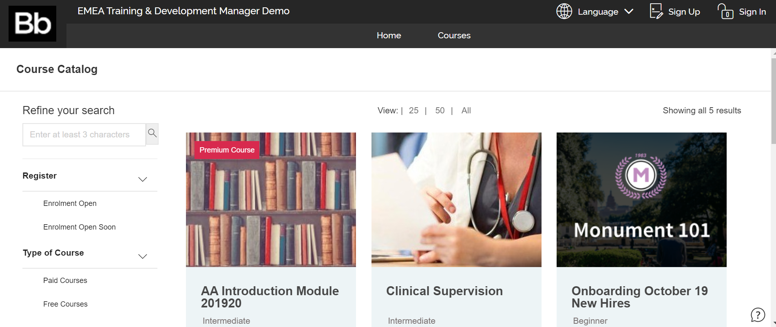
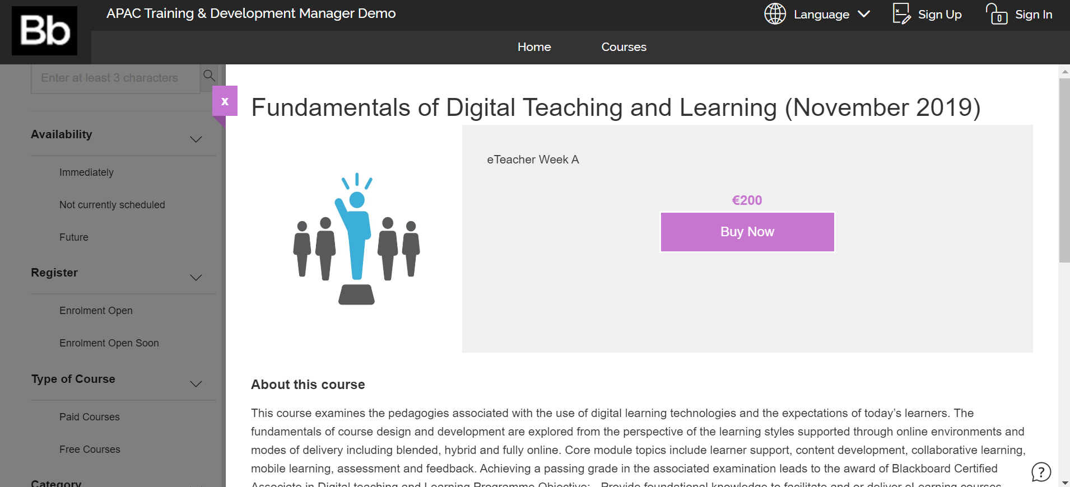
Training and Development Manager
Course catalog marketplace, providing ability to offer online non-credit continuing education courses and certificates
Course Catalog with Self Enrollment
Learning Self-Account Creation
Dashboards and Certificates
Payment Gateway
Notes:
We’re also seeing significant need for providing access to digital learning content and activities for users who might not yet be admitted NIU students or for online non-credit bearing continuing education outside of the traditional academic course. As part of the LMS Review, we are planning to pilot the bolt-on capability that Blackboard offers called “Training and Development Manager” that allows institutions to set-up a course catalog marketplace, registration with an optional payment gateway, and provide non-credit bearing courses and learning opportunities. This capability is essential to provide prospective students or alumni the ability to self-enroll in learning modules or courses without an active student account ID. This is very useful for academic programs that wish provide new types of unbundled or stackable offerings for prospective students or alumni, offering a taste of the learning experience in the program, that may then generate interest for prospective students to enroll. Like the previously mentioned Ally for Accessibility, this new capability is one that NIU has not previously licensed, but we are looking to adopt for the future.

Slide 6
Review Task Force
Project Co-Chairs
Executive Committee
Advisory Committee
Technical Committee
Project co-chairs, project manager, one member from the technical committee and two members from the advisory committee
Representatives from across university stakeholder groups, average of 8 years of experience with Blackboard and use of over 2 LMS’s each
Responsible for operationalizing the review of systems, engagement with key stakeholders, and collection of evaluation data.
Notes:
Let me now provide some brief background into our review thus far. In October 2020 Provost Ingram authorized the LMS review and for it to be jointly coordinated by the Center for Innovative Teaching and Learning and the Division of Information Technology. Given the widespread and longstanding use of the LMS, a task force with broad and inclusive representation was formed with members nominated by colleges and stakeholder units from across the university, consisting of the following:
Executive Committee. Responsible for execution of the review, including the solicitation of feedback, development of a communications plan, and presentation of a final report.
Advisory Committee. Representatives from across university stakeholder groups who provide input into the evaluation process and establishment of evaluation review criteria. The advisory committee members represent both novices and power-users of learning management systems, with an average of 8 years of experience with Blackboard. They have also used a wide variety of learning management systems, with an average of 2.2 systems each.
Technical Committee. Responsible for operationalizing the review of systems, engagement with key stakeholders, and collection of evaluation data. Technical committee members comprise the technical subgroup of the advisory committee.

Slide 7
Advisory Committee Representation
Faculty Representatives from each college (8 total)
Instructor Representatives (3 total)
Student Success Representative
Student Affairs Representative
Staff Representatives (2 total)
Student Representatives (3 total)
Graduate Student Teaching Assistant Representative
Communications Representative
Outreach, Engagement, and Regional Development Representative
21 Advisory Committee Members
Notes:
The Advisory Committee consists of a broad and inclusive representation of university stakeholders and were nominated by deans and other institutional leadership to provide a diverse and balanced perspective and input into the review process. And to reiterate, these representatives on average have used more than one LMS, so they bring an important perspective and experience using alternatives to Blackboard.
The Advisory Committee has had an important role in establishing the evaluation process and evaluation review criteria along with providing feedback on the features and capabilities of each system.

Slide 8
Additional Internal Engagement
Office of the Executive Vide President and Provost
Council of Deans
Associate Deans
Department Chairs/Directors
Faculty Senate
Academic Planning Council (APC)
Innovative Teaching and Learning Advisory Committee (ITLAC)
IT Planning Council (ITPC)
Computing Facilities Advisory Committee (CFAC)
Student Government Association (SGA)
Notes:
Additional Internal Engagement. Beyond the aforementioned individuals serving collectively as the LMS Review Task Force, these listed internal stakeholder groups have been engaged throughout the review process and provided with status updates along with opportunities for feedback.
Now I’d like to turn the presentation over to Matt Parks to discuss the Review Process and Timeline and Next Steps.

Slide 9
Review Process and Timeline
OCT 2020 Project authorized and task force formed
DEC 2020 Begin drafting review criteria and rubrics for review
FEB 2021 Schedule product demos and announce
APR 2021 Conduct focus groups and enable sandboxes
JUN 2021 Recommendation to Board for approval and procurement
NOV 2020 Kick-off meetings and input sought to define review criteria
JAN 2021 Finalize criteria and hold initial vendor meetings
MAR 2021 Conduct vendor demos and survey campus attendees
MAY 2021 Compile cost comparisons and finalize review findings
Notes:
[Matt] Thanks Jason. The review process has been comprehensive and transparent, with detailed criteria and metrics for evaluation and scoring. The Executive Committee met with each vendor to provide an overview of NIU’s review process and topics for inclusion in campus demonstration presentations. Subsequent steps in the review have included:
Each vendor met with the Executive Committee to provide background into their history as a company, general overview of solution, and roadmap ahead -- information that provided additional context in advance of campus demonstrations.
Each vendor provided a test instance of their platform for technical review and access to existing documentation; Technical Committee then reviewed the systems and rated each according to the full list of technical criteria.
Executive Committee and Technical Committee requested written responses to additional questions based on the technical review.
Each vendor provided two virtual demonstrations for faculty, staff, and students to attend on functionality for teaching and learning. Demonstrations were recorded and made available for NIU users to view on the LMS review website. Participants completed follow-up surveys to rate each system’s functionality.
Each vendor provided separate virtual demonstrations of shopping cart features for outside learners and external programming. Participants similarly completed follow-up surveys to rate the system’s functionality.
Technical Committee built sample courses in each system with identical content and conducted focus group sessions with Advisory Committee and other NIU constituent groups. Focus groups compared the courses from each system and rated the systems’ functionality.
Each vendor provided references of client institutions comparable to NIU for the Executive Committee to reach out to for their institutional experience and feedback.
We’ve heard independently from each vendor that our review is among the most comprehensive and transparent of any institution they’ve ever seen.

Slide 10
Next Steps
Feedback is being compiled and analyzed, with each platform being scored according to criteria and rubrics established by the task force.
Final report and recommendation to be prepared for senior leadership
Update on the review process and outcomes along with a request for Board approval at the Board of Trustees meeting on June 17th
To allow time for the review to be conducted and a potential transition to a new system if that is the outcome of the review, a one-year renewal of Blackboard is being sought that would extend our current agreement with Blackboard through FY22
Notes:
As far as next steps, feedback is being compiled and analyzed, with each platform being scored according to criteria and rubrics established by the Task Force. The Task Force is working to have a final report and recommendation prepared for senior leadership by the end of May, with an update on the review process and outcomes along with a request for Board approval at the June Board of Trustees meeting.
To allow time for the review to be conducted and a potential transition to a new system if that is the outcome of the review, a one-year renewal of Blackboard is being sought that would extend our current agreement with Blackboard through FY22. This request is being submitted in a separate item to the Board of Trustees Finance, Audit, Compliance, Facilities and Operations Committee at their meeting later today.
We’re happy to take any questions from the committee at this time.

